Slide 1
Design and Analysis of Algorithms
Shortest Paths I(Ch24)

Slide 2
Design and Analysis of Algorithms
Shortest Paths I
Topics:
Shortest paths
Dijkstra’ algorithm

Slide 3

Paths in graphs
Consider a digraph G=(V,E), with edge-weight function w : E→R. The weight of path p=v₁→v₂--…→v_{k} is defined to be
w(p)=∑_{i=1..k-1}w(v_{i} ,v_{i+1})
Example:

Slide 4
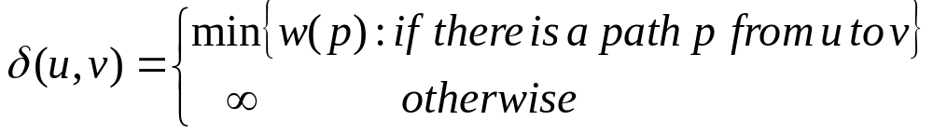
Shortest paths
A shortest path from u to v is a path of minimum weight from u to v. The shortest-path weight form u to v is defined as

Slide 5

Optimal structure
Theorem. A subgraph of shortest path is a shortest path.
Proof. Cut and paste:
v₆

Slide 6
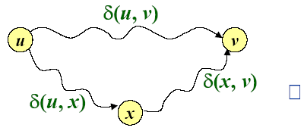
Triangle inequality
Theorem. For all u,v,x∈V, we have
δ(u,v) ≤δ(u,x)+δ(x,v)
Proof.

Slide 7
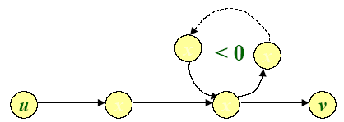
Well-definedness of shortest paths
If a graph G contains a negative-weight cycle, then some shortest paths may not exist.

Slide 8
Single-source shortest paths
Problem. From a given source vertex s∈V, find the shortest-path weightδ(s,v) for all v∈V.
If all edge weight w(u,v) are nonnegative, all shortest-path weights must exist.
IDEA: Greedy
1. Maintain a set S of vertices whose shortest-path distances from s are known
2. At each step add to S the vertex v∈V-S whose distance estimate from s is minimal.
3. Update the distance estimates of vertices adjacent to v.

Slide 9
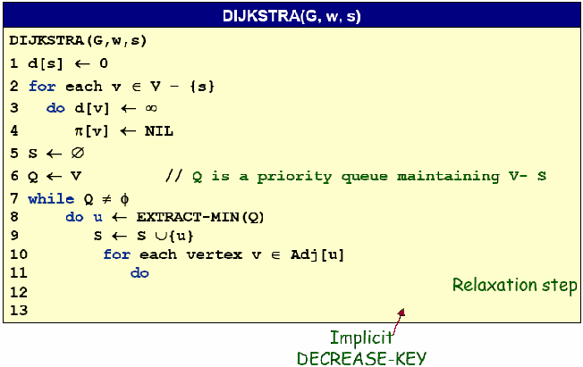

Dijkstra’s algorithm

Slide 10
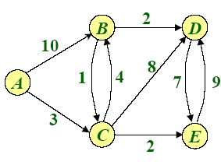
Example of Dijkstra’s algorithm
Graph with nonnegative edge weights:

Slide 11
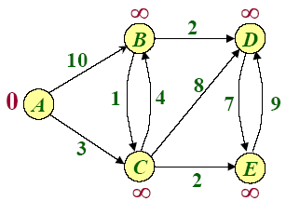
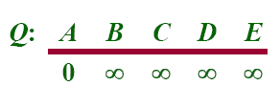

Example of Dijkstra’s algorithm
Initialize:

Slide 12

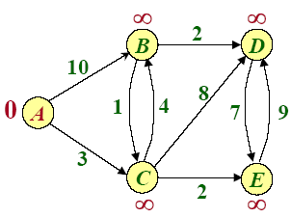


Example of Dijkstra’s algorithm

Slide 13
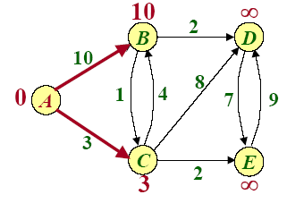
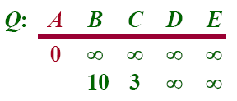
Example of Dijkstra’s algorithm
Relax all edges leaving A :

Slide 14

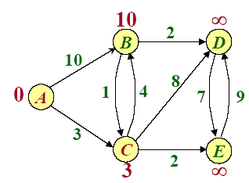
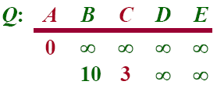

Example of Dijkstra’s algorithm

Slide 15
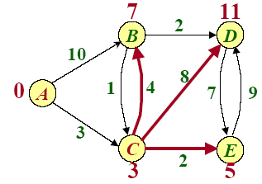
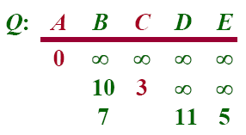
Example of Dijkstra’s algorithm
Relax all edges leaving C :

Slide 16

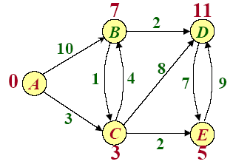
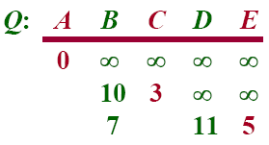

Example of Dijkstra’s algorithm

Slide 17
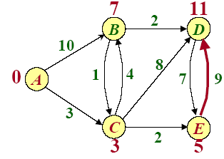
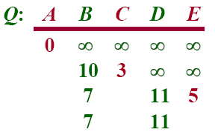
Example of Dijkstra’s algorithm
Relax all edges leaving E :

Slide 18

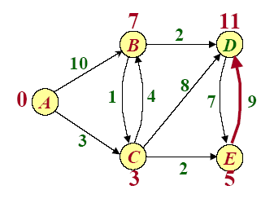
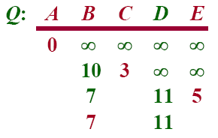

Example of Dijkstra’s algorithm

Slide 19
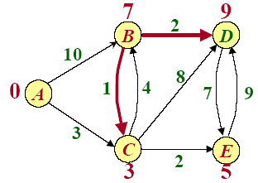
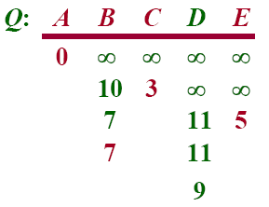
Example of Dijkstra’s algorithm
Relax all edges leaving B :

Slide 20

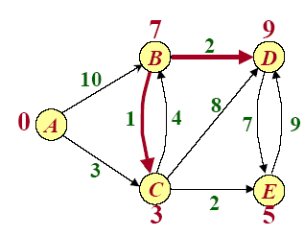
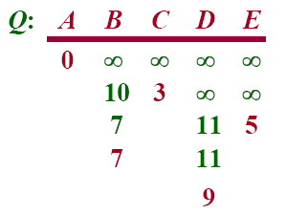

Example of Dijkstra’s algorithm

Slide 21
Simple Review
Knapsack Problem
  0/1
Huffman codes
Shortest paths
  Dijkstra’s algorithm
Notes:
For master only!

Slide 22
Dijkstra’s algorithm

Slide 23
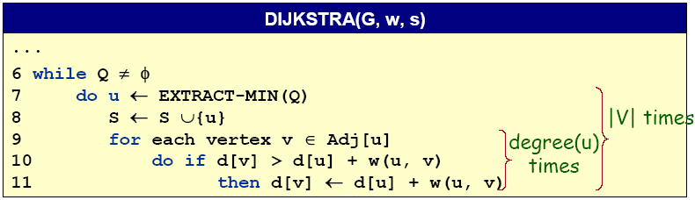
Analysis of Dijkstra’s algorithm
Hanshaking Lemma→Θ(E) implicit DECREASE-KEY’s
Time=Θ(V.T_{EXTRACT-MIN}+E.T_{DECREASE-KEY})
Note: Same formula as in the analysis of Prim’s minimum spanning tree algorithm.

Slide 24
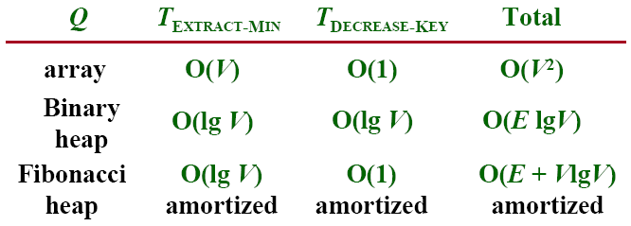
Analysis of Dijkstra’s algorithm
Time=Θ(V.T_{EXTRACT-MIN}+E.T_{DECREASE-KEY})
Notes:
在平摊分析中，执行一系列数据结构操作所需要的时间是通过执行的所有操作求平均而得出的。平摊分析可以用来证明在一系列操作中，通过对所有操作求平均之后，即使其中单一的操作具有较大的代价，平均代价还是很小的。
平摊分析不牵涉到概率, 平摊分析保证在最坏情况下，每个操作具有的平均性能。
第三版教材中有Dijkstra算法正确性证明的循环不变式方法

Slide 25
Example of Dijkstra’s algorithm
-8
9

Slide 26
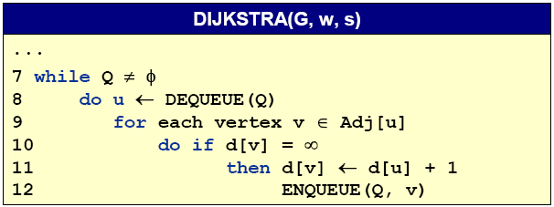
Unweighted graphs
Suppose that w(u,v)=1 for all (u,v) ∈E. Can Dijkstra’s algorithm be improved?
-- Use a simple FIFO queue instead of a priority queue.
Breadth-first search
Analysis: Time=O(V+E)

Slide 27
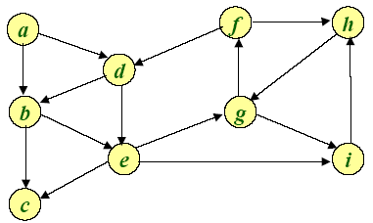
Example of Breadth-first search
Q:

Slide 28
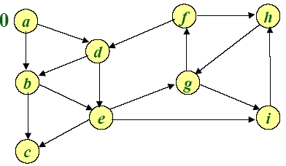
Example of Breadth-first search
0
Q: a

Slide 29
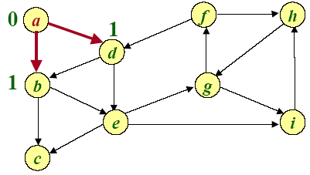
Example of Breadth-first search
1 1
Q: a b d

Slide 30
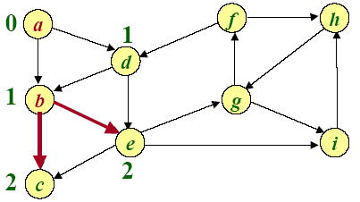
Example of Breadth-first search
1 2 2
Q: a b d c e

Slide 31
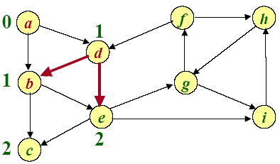
Example of Breadth-first search
2 2
Q: a b d c e

Slide 32
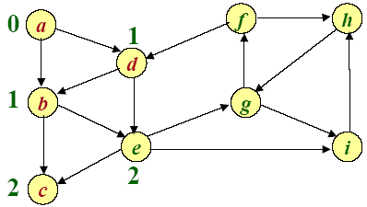
Example of Breadth-first search
2
Q: a b d c e

Slide 33
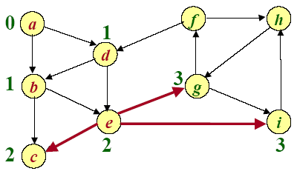
Example of Breadth-first search
3 3
Q: a b d c e g i

Slide 34
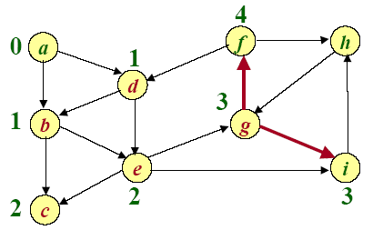
Example of Breadth-first search
3 4
Q: a b d c e g i f

Slide 35
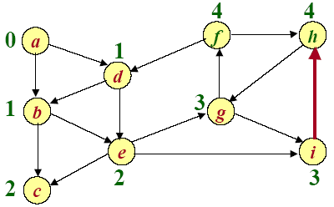
Example of Breadth-first search
4 4
Q: a b d c e g i f h

Slide 36
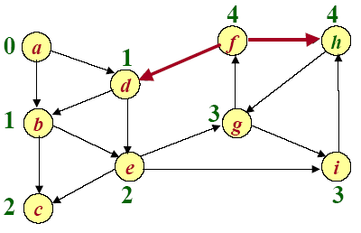
Example of Breadth-first search
4
Q: a b d c e g i f h

Slide 37
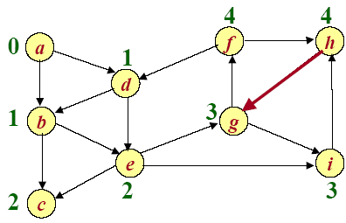
Example of Breadth-first search
Q: a b d c e g i f h

Slide 38
Design and Analysis of Algorithms
Navigation in a Small World
Reference:
The small world web by Lada A. Adamic
The small-world phenomenon: an algorithmic perspective by J. Kleinberg
Diameter of the World-Wide Web by Albert, Nature
Perspective: network analysis—the structure of the web by Kleinberg and Lawrence, Science

Slide 39
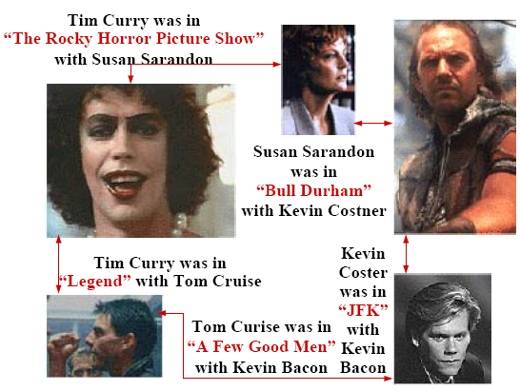
Small World Phenomenon

Slide 40
Small World Phenomenon
Small world phenomenon.
-- Six handshakes away from anyone else in the world.
-- Long a matter of folklore.
-- “It’s a small world after all.”
Stanley Milgram experiment (1960s) quantified effect.
-- You are given personal info of another person in US, e.g., occupation.
-- Goal: deliver message.
-- Restriction: can only forward to someone you know by first name.
-- Outcome: message delivered with average of 5 intermediaries.
Application demands new ADT.
-- Graph = data type that represents pairwise connections.
-- Vertex = element.
-- Edge = connection between two vertices.

Slide 41
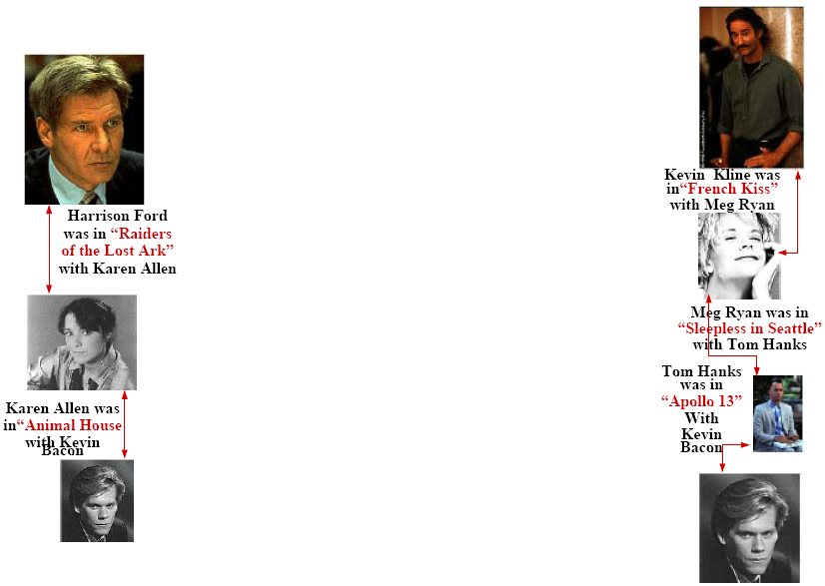

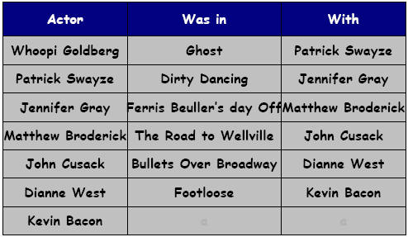
Kevin Bacon Game
Game: given actor, find chain of movies connecting them to Kevin Bacon

Slide 42
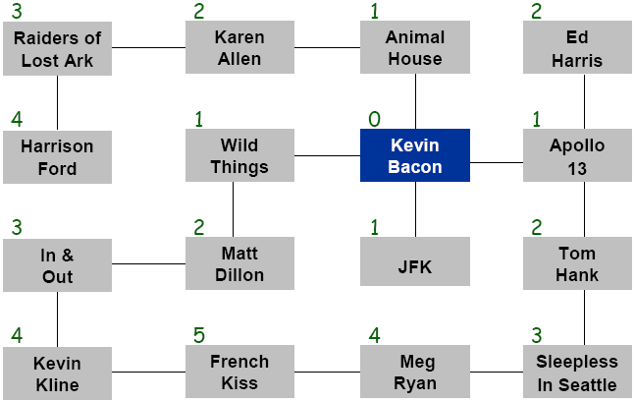
Bacon numbers
Bacon number: length of shortest such chain to Kevin Bacon.
How to compute: find shortest path in graph, and divide length by 2.

